Slide 1
Documentation and Testing
Best Practices for Data Scientists
Dr. Péter Molnár
October 7, 2023

Slide 2
Documentation and Testing
Make code understandable with sufficient documentation and testing
Verify integrity of the code during development
Run-time test for data and model may look similar…though need to be handled separately
Documentation
Comments: Anywhere in the code (line, block)
Docstrings: Multi-line string for functions and classes
Brief description of purpose and requirements or limitations
Input parameters
Return values
Testing
Run parts of the code (on sample data)
Verify that the code produces the expected output and doesn’t break
Perform manually: run in notebook, review output files and screen shots, keep records
Automated testing:

Slide 3
Style and Documentation
Generally style is built into Python, as it demands indents.
However, good Python style is set out in PEP8:
https://www.python.org/dev/peps/pep-0008/
Use 4 spaces per indent, rather than tabs.
Use blank lines before function definitions, and to separate logical code units.
function_names; variable_names; keyword_named_variables_; ClassNames; modname; CONSTANT_NAMES
Keep lines to 79 characters or less.
Spaces around operators and after commas, but not just inside (){}[]: a = (1, 2)
Indent comments to the level of the code referred to.
Agree on naming conventions within your team or organization
Consider application across all platforms and programming languages
Notes:
Note that it is bad practice to call a variable the same as a keyword, but you can use a trailing underscore to distinguish if you must.

Slide 4
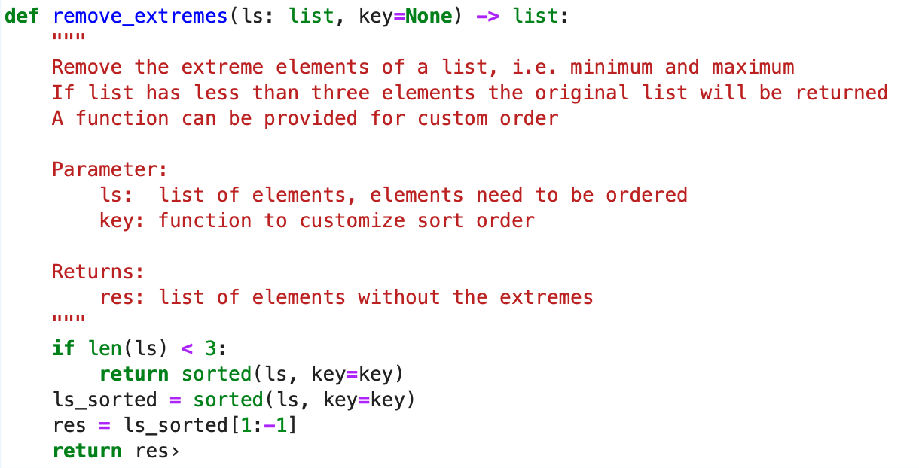
Example with Docstrings and Type Hints
Triple quotes after def statement
There are different styles for content
No formal syntax

Slide 5
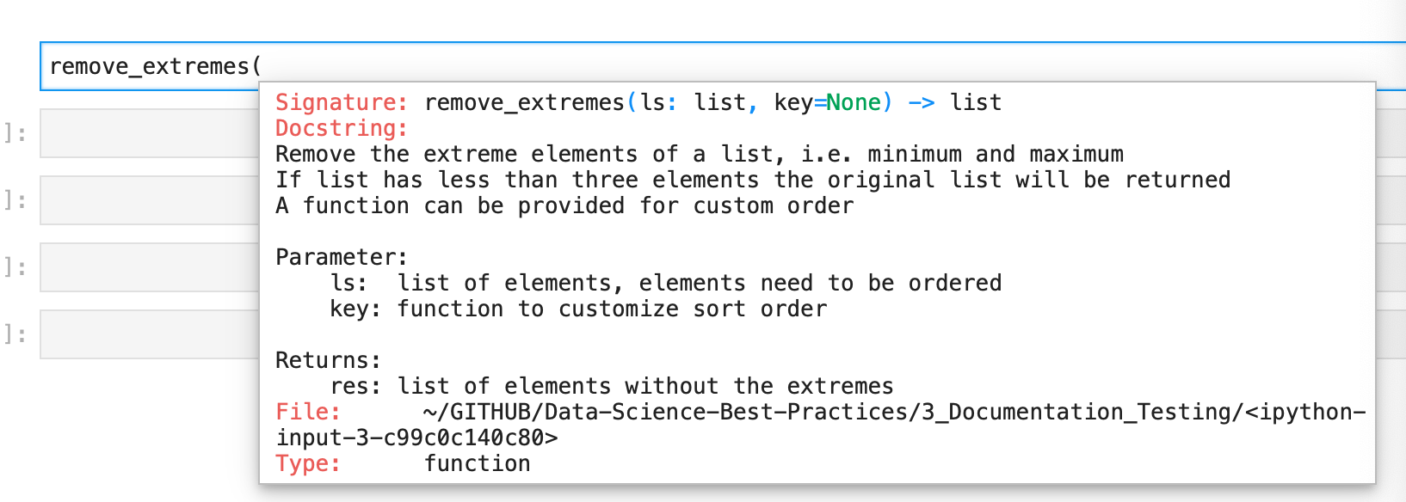
Doc String Support in Jupyter Notebooks
hit <Shift><Tab>

Slide 6
PyDoc Tool
PyDoc is the documentation system distributed with Python https://docs.python.org/3/library/pydoc.html
Use from the command line to
Show docstrings for a Python program/module $ pydoc functions $ pydoc functions.get_anchor_word_window_by_sent
Create an HTML document $ pydoc –w functions produces HTML file “functions.html”
Interactive Web-UI to browse documentation of modules in current folder and the packages they use $ pydoc –b opens default web browser for UI
Notes:
"""
Add two random numbers together
Requires no setup.
"""
import random
def add (num1, num2):
"""
Add two numbers.
Postional arguments:
num1 -- an integer or double number (no default)
num2 -- an integer or double number (no default)
Returns:
The sum of the numbers.
"""
return num1 + num2
numA = random.random() * 10
numB = random.random() * 10
print(add(numA, numB))
# Download this file
# Run it with
# python -i docs.py
# This will run the file and leave you at the command prompt, with the file imported.
# Now try
# help(add)

Slide 7
Other software
There is a starter list of alternative software at:
https://wiki.python.org/moin/DocumentationTools
A popular one is Sphinx, which comes with Anaconda:
http://www.sphinx-doc.org/en/stable/
http://www.sphinx-doc.org/en/stable/tutorial.html
http://www.sphinx-doc.org/en/stable/invocation.html#invocation-apidoc
Notes:
Make a docs directory, and copy docs.py into it.
Open a command prompt.
sphinx-quickstart
Root path for documentation[.]: <ENTER>
Separate source and build directories(y/n)[n]: <ENTER>
Name prefix for templates and static directories[_]: <ENTER>
Project name: docstest
Author: Your name
Project version: 1
Project release: <ENTER>
Project language [en]: <ENTER>
Source file suffix [.rst]
Name of your master document (without suffix)[index]: <ENTER>
Do you want to use the epub builder (y/n) [n]: <ENTER>
autodoc: automatically insert docstrings from modules (y/n) [n]: <ENTER>
doctest: automatically test code snippets in doctest blocks (y/n) [n]: <ENTER>
intersphinx: link between Sphinx documentation of different projects (y/n) [n]: <ENTER>
todo: write "todo" entries that can be shown or hidden on build (y/n) [n]: <ENTER>
coverage: checks for documentation coverage (y/n) [n]: <ENTER>
pngmath: include math, rendered as PNG images (y/n) [n]: <ENTER>
mathjax: include math, rendered in the browser by MathJax (y/n) [n]: <ENTER>
ifconfig: conditional inclusion of content based on config values (y/n) [n]: <ENTER>
viewcode: include links to the source code of documented Python objects (y/n) [n]: <ENTER>
Create Makefile? (y/n) [y]: <ENTER IF ON MAC>
Create Windows command file? (y/n) [y]: <ENTER IF ON WINDOWS>
Make a directory _source
Copy in docs.py
sphinx-apidoc -o _source _source
Copy index.rst into _source
sphinx-build -c . -b html _source _build

Slide 8
Testing

Slide 9
Code Testing
Unit
Integration
Regression
You should test that the program works the way a user/customer expects the application to work. Acceptance tests ensure that the functionality meets business requirements.
Acceptance
After integrating (and maybe fixing) you should run your unit tests again. This is regression testing to ensure that further changes have not broken any units that were already tested. You can run your unit tests again and again for regression testing
You test the integrations of many units together.
You test each individual piece of code.
Think each class or method.
You make sure your code works when put together, including dependencies, databases and libraries.
usually, automated
http://www.getlaura.com/testing-unit-vs-integration-vs-regression-vs-acceptance/

Slide 10
Unit Tests vs Regression Tests
UNIT TESTS
A unit test is a test written by a programmer to verify that a relatively small piece of code is doing what it is intended to do. They are narrow in scope, they should be easy to write and execute, and their effectiveness depends on what the programmer considers to be useful..
Unit tests shouldn’t have dependencies on outside systems. They test internal consistency as opposed to proving that they play nicely with some outside system.
REGRESSIONS TESTS
Regression tests are performed whenever anything has been changed in the system in order to check that no new bugs have been introduced.
This means you re-run your unit and intergration tests after all patches, upgrades, and bug fixes. Regression testing can be seen as a special case of combined unit test and integration test.
http://www.getlaura.com/testing-unit-vs-integration-vs-regression-vs-acceptance/

Slide 11
How to write (unit) tests
Free Style For manual testing and human validation of test results.
Notebooks or scripts that use code on sample data Use assert statement or conditional statements
Must use the same code base, i.e., Python file
Use %loadpy or import in notebooks
Doctest
Suitable for simple unit-tests for functions.
Include test case as part of docstrings in Python code.
Advantage: Test cases reside close to function definition.
Disadvantage: Limited to simple tests
unittest
Formal method to conduct unit tests.
Can be integrated with automated testing environments.
Requires writing separate code (TestCase classes)
Allows (more) complex test cases.
Advanced Tools
A number of tools to develop automated test script. Often part of the deployment pipeline
Packages:
py.test
Hypothesis
tox
Mock
https://docs.python-guide.org/writing/tests/

Slide 12
Test in Documentation
"""
Add two numbers together.
>>> add(1,2)
3
"""
def add (num1, num2):
return num1 + num2
def mult(num1, num2):
"""
Multiply two numbers.
Parameters:
num1 -- number
num2 -- number
Returns:
product of the numbers
>>> mult(4,7)
28
"""
return num1 * num2
$ python3.9 -m doctest -v arithmetic.py
Trying:
add(1,2)
Expecting:
3
ok
Trying:
mult(4,7)
Expecting:
28
ok
1 items had no tests:
arithmetic.add
2 items passed all tests:
1 tests in arithmetic
1 tests in arithmetic.mult
2 tests in 3 items.
2 passed and 0 failed.
Test passed.
https://docs.python.org/3/library/doctest.html

Slide 13
Test with unittest
# arithmetic.py
def add (num1, num2):
"""
Add two numbers together.
"""
return num1 + num2
def mult(num1, num2):
"""
Multiply two numbers.
Parameters:
num1 -- number
num2 -- number
Returns:
product of the numbers
"""
return num1 * num2
# tests.py
import unittest
import arithmetic
class TestDocs(unittest.TestCase):
def test_add(self):
self.assertEqual(docs.add(1,2), 3)
if __name__ == '__main__':
unittest.main()
$ python tests.py
$ python -m unittest -v tests.py
create separate test code
https://docs.python.org/3/library/unittest.html
https://docs.python.org/3/library/unittest.html#assert-methods

Slide 14

Test Driven Development
More applicable to software development – still we may consider these ideas for data science projects:
Write the tests first, and then write the software to match the tests.
Good for working in teams: if the code matches the test, it shouldn't matter how it does it.
All team code uploaded to a shared repository should be tested.
References:
https://docs.python-guide.org/writing/tests/
https://en.wikipedia.org/wiki/Test-driven_development
https://en.wikipedia.org/wiki/Continuous_integration

